Slide 1
11
Correlation

Slide 2
Correlation
Association between scores on two variables
  Ex.: age and coordination skills in children, price and quality

Slide 3
Graphing Correlations:
The Scatter Diagram -1
Steps for making a scatter diagram
  Draw axes and assign variables to them
  Determine range of values for each variable and mark on axes
  Mark a dot for each person’s pair of scores

Slide 4
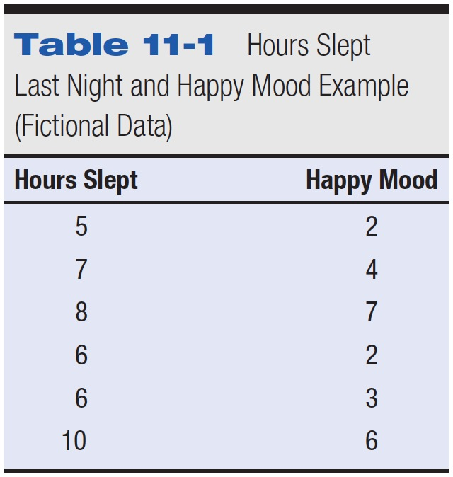
Table 11-1 Hours Slept Last Night and Happy Mood Example (Fictional Data)

Slide 5
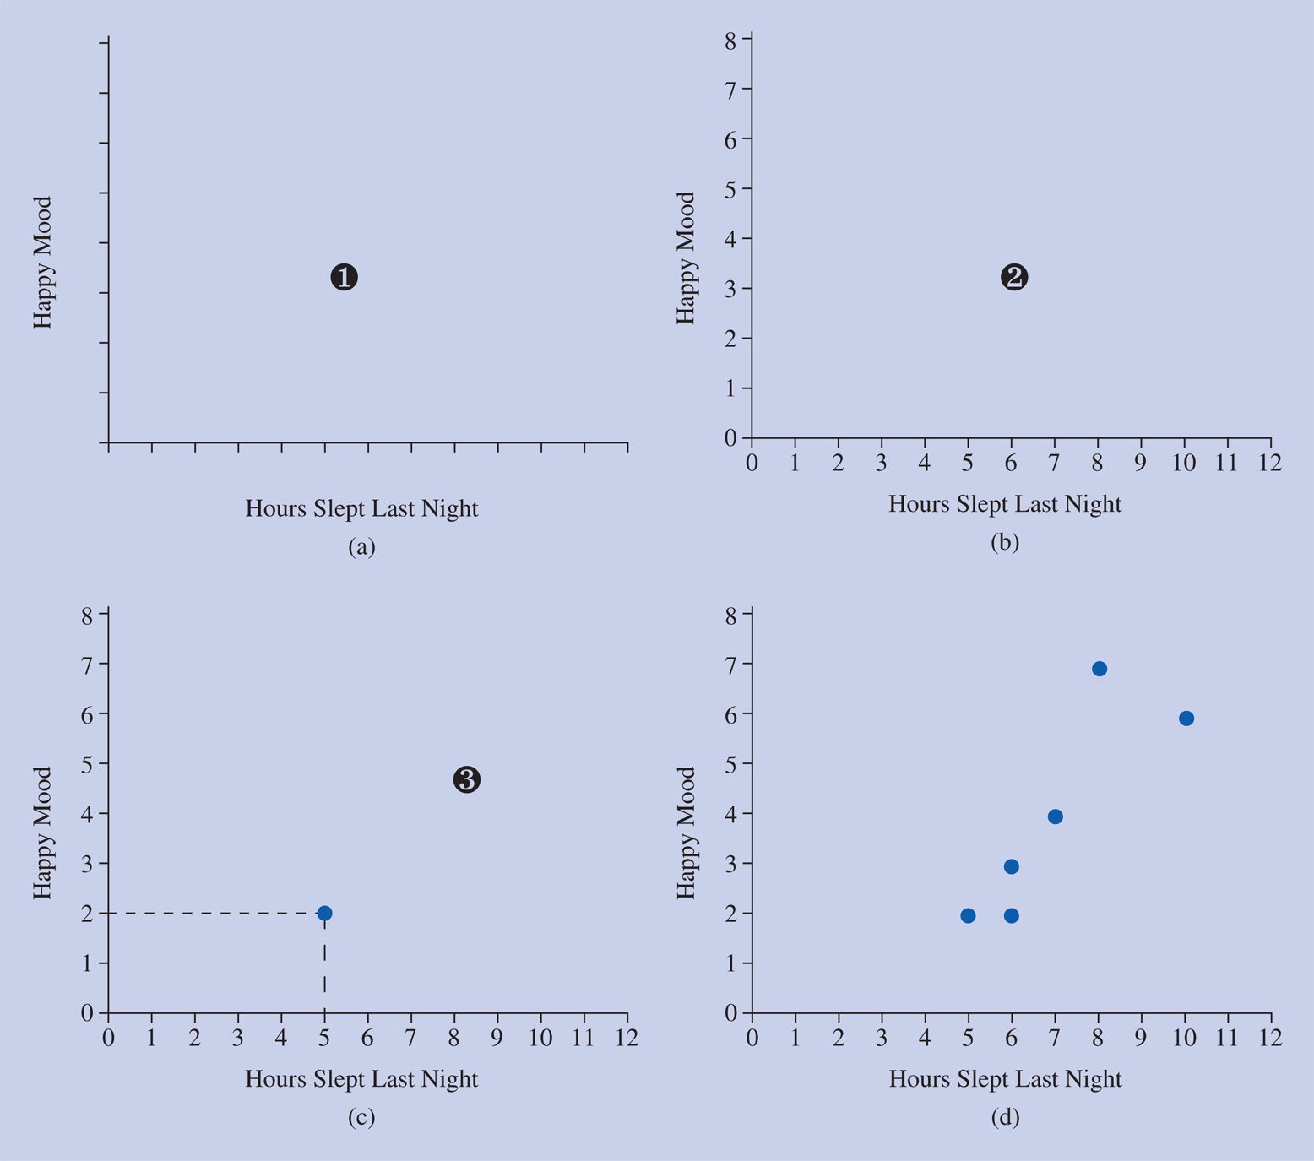
Figure 11-2 Steps for making a scatter diagram. (a) (1) Draw the axes and decide which variable goes on which axis—the predictor variable (Hours Slept Last Night) on the horizontal axis, the other (Happy Mood) on the vertical axis. (b) (2) Determine the range of values to use for each variable and mark them on the axes. (c) (3) Mark a dot for the pair of scores for the first student. (d) (3) continued: Mark dots for the remaining pairs of scores.

Slide 6
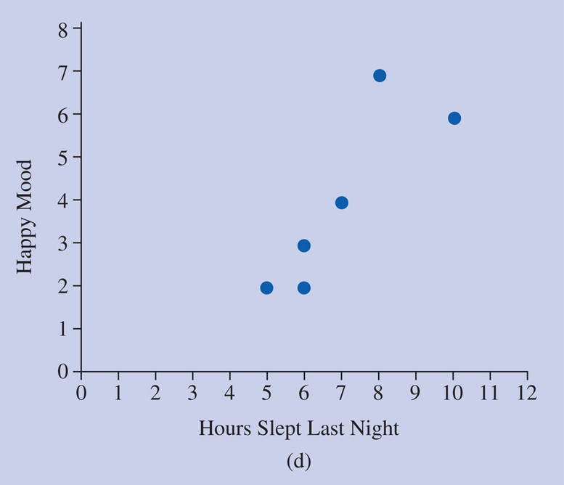
Linear Correlation
Describes a situation where the pattern of dots falls roughly in a straight line

Slide 7
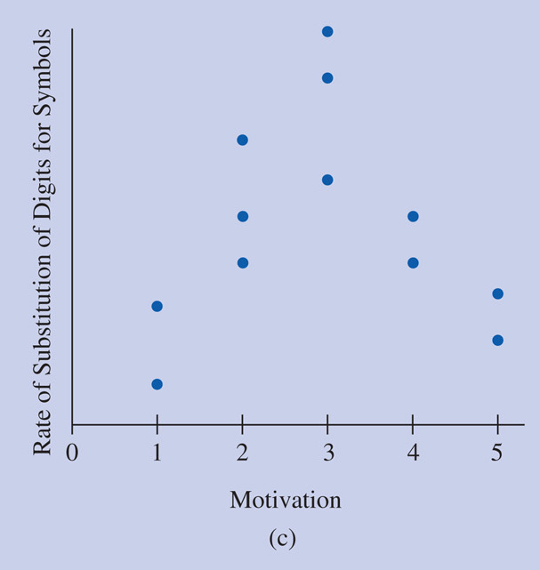
Curvilinear Correlation
Pattern of dots is curved, not in a straight line

Slide 8
Positive Correlation
Pattern of dots goes up from left to right
  High scores on one variable go with high scores on the other variable
  Low scores on one variable go with low scores on the other variable
  Middle scores go with middle scores

Slide 9
Negative Correlation
Pattern of dots goes down from left to right
  High scores on one variable go with low scores on the other variable
  Low scores on one variable go with high scores on the other variable
  Middle scores go with middle scores

Slide 10
Strength of Correlation
How much is there a clear pattern of relationship between variables
Why is pattern important?
  If you don’t check a scatterplot first, then you might miss a relationship

Slide 11
Correlation Coefficient
Correlation tells you two things:
  1. Direction: positive, negative
  2. Magnitude: how strong the relationship is

Slide 12
Degree of Linear Correlation:
The Correlation Coefficient -1
Figure correlation using Z scores
Cross-product of Z scores
  Multiply Z score on one variable by Z score on the other variable
Correlation coefficient
  Average of the cross-products of Z scores

Slide 13
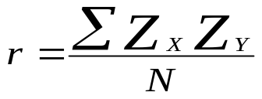
Degree of Linear Correlation:
The Correlation Coefficient -2
General formula for the correlation coefficient:
Positive perfect correlation: r = +1
No correlation: r = 0
Negative perfect correlation: r = –1

Slide 14
Interpreting a Correlation
A correlation is strong and positive if highs on one variable go with highs on the other, and lows with lows
A correlation is strong and negative if lows go with highs, and highs with lows
There is no correlation if sometimes highs go with highs and sometimes with lows

Slide 15
Hypothesis Testing
Similar to a dependent/single sample t test.
Test if correlation is different from 0 or some proposed population correlation.

Slide 16
Hypothesis Testing
Null: Correlation is not different from population or 0.
Res: Correlation is different from population or 0.

Slide 17
Comparison Distribution
List r
DF = (N-2)

Slide 18
Cut Off Score
T distribution!
T(df) p < .05

Slide 19
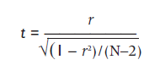
Significance of the
Correlation Coefficient
t is used to determine the significance of a correlation
coefficient
with df = N-2

Slide 20
Reject?
Is step 3 (t cut off score) < step 4 (t critical for our sample correlation)?

Slide 21
Assumptions
Homogeneity = equal variances
Normal distribution
Homoscedasticity – equal distribution of each variable at each point of the variable

Slide 22
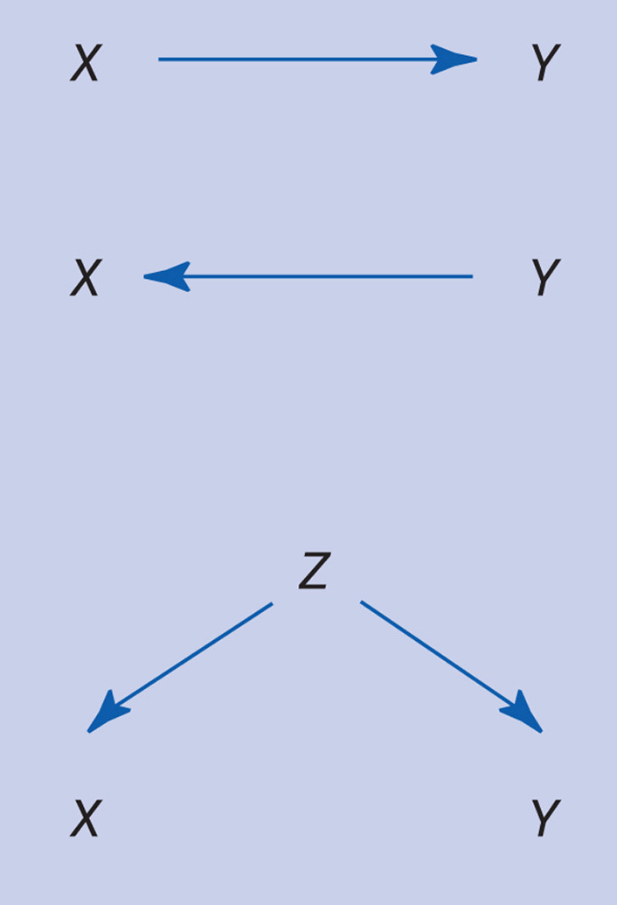
Correlation and Causality -1

Slide 23
Correlation and Causality -2
Correlational research design
  Correlation as a statistical procedure
  Correlation as a research design

Slide 24
Issues in Interpreting the Correlation Coefficient
Statistical significance – practical versus statistical signficiance
Proportionate reduction in error
  r²
  Used to compare correlations
Copyright © 2009 Pearson Education, Inc. Upper Saddle River, NJ 07458. All rights reserved.

Slide 25
Issues in Interpreting the Correlation Coefficient
Restriction in range – situation in which you figure a correlation but only a limited range of the possible values on one of the variables is included in the group studied
Copyright © 2009 Pearson Education, Inc. Upper Saddle River, NJ 07458. All rights reserved.

Slide 26
Issues in Interpreting the Correlation Coefficient
Unreliability of measurement – maybe you didn’t get a correlation because your measuring tool sucks
Curvilinearity
  Spearman’s rho – the equivalent of a correlation for rank ordered variables
Copyright © 2009 Pearson Education, Inc. Upper Saddle River, NJ 07458. All rights reserved.

Slide 27
Issues in Interpreting the Correlation Coefficient
Outliers – scores with extreme value in relation to the other scores in the distribution
  One outlier can totally change a correlation coefficient
Copyright © 2009 Pearson Education, Inc. Upper Saddle River, NJ 07458. All rights reserved.
Notes:
`

Slide 28
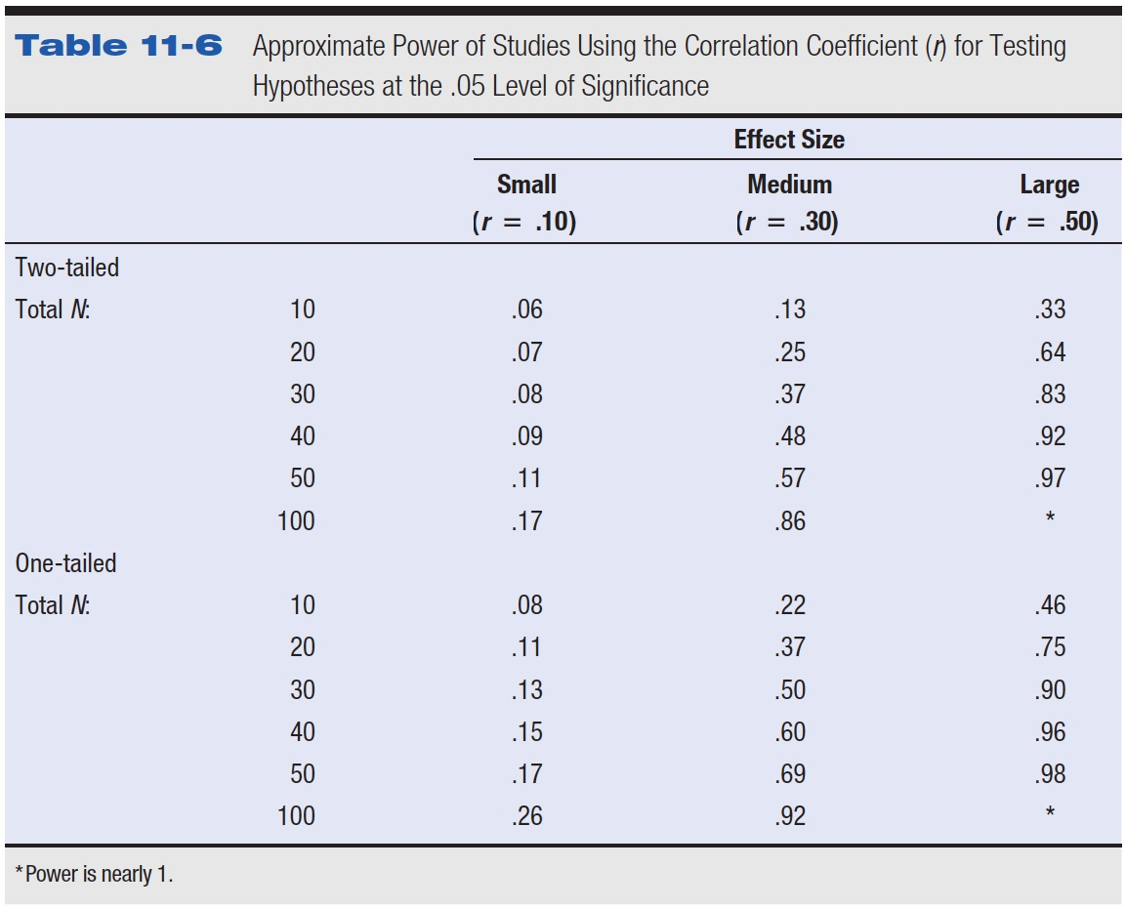
Table 11-6 Approximate Power of Studies Using the Correlation Coefficient (r) for Testing Hypotheses at the .05 Level of Significance

Slide 29
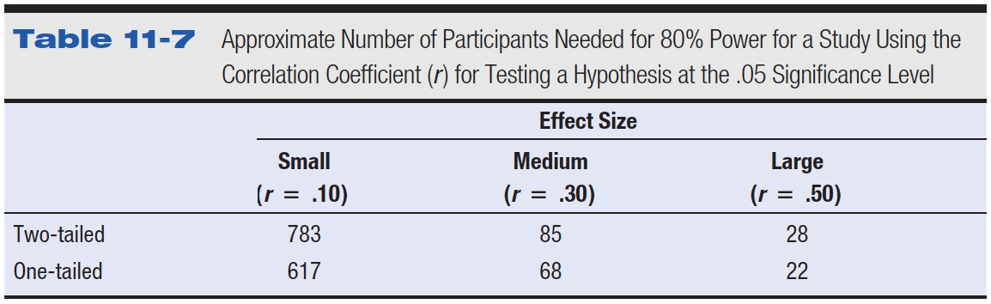
Table 11-7 Approximate Number of Participants Needed for 80% Power for a Study Using the Correlation Coefficient (r) for Testing a Hypothesis at the .05 Significance Level

Slide 30
Correlation in Research Articles
Scatter diagrams occasionally shown
Correlation matrix

Slide 31
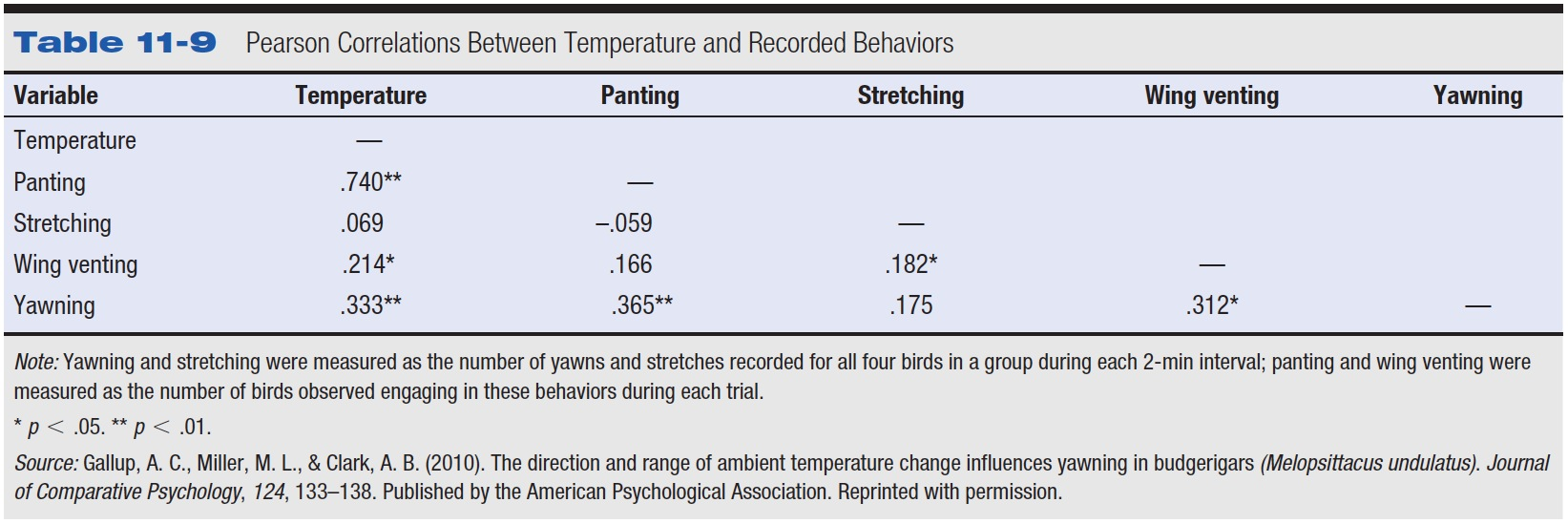
Table 11-9 Pearson Correlations Between Temperature and Recorded Behaviors

Slide 32
An experimenter conducted a study of the relation of dominance behavior to size in a particular species of bird using size as the predictor variable. The results for the first three birds observed were as follows.
Size of Bird Dominance Behavior
14 82
18 82
10 70
a. Make a scatter diagram of the raw scores.
b. Describe in words the general pattern of association, if any.
c. Figure the correlation coefficient.
d. Determine whether the correlation is statistically significant using the .05 significance level and a two-tailed test.

Slide 33
Is there a relationship between income and education, using p<.01?
Participant Income Years of Education
  #1 125,000 19
  #2 100,000 20
  #3 40,000 16
  #4 35,000 16
  #5 41,000 18
  #6 29,000 12
  #7 35,000 14
  #8 24,000 12
  #9 50,000 16
  #10 60,000 17

